Slide 1
NBICS Technologies
Alexander Aksentyev
National Research Nuclear University “MEPhI”

Slide 2
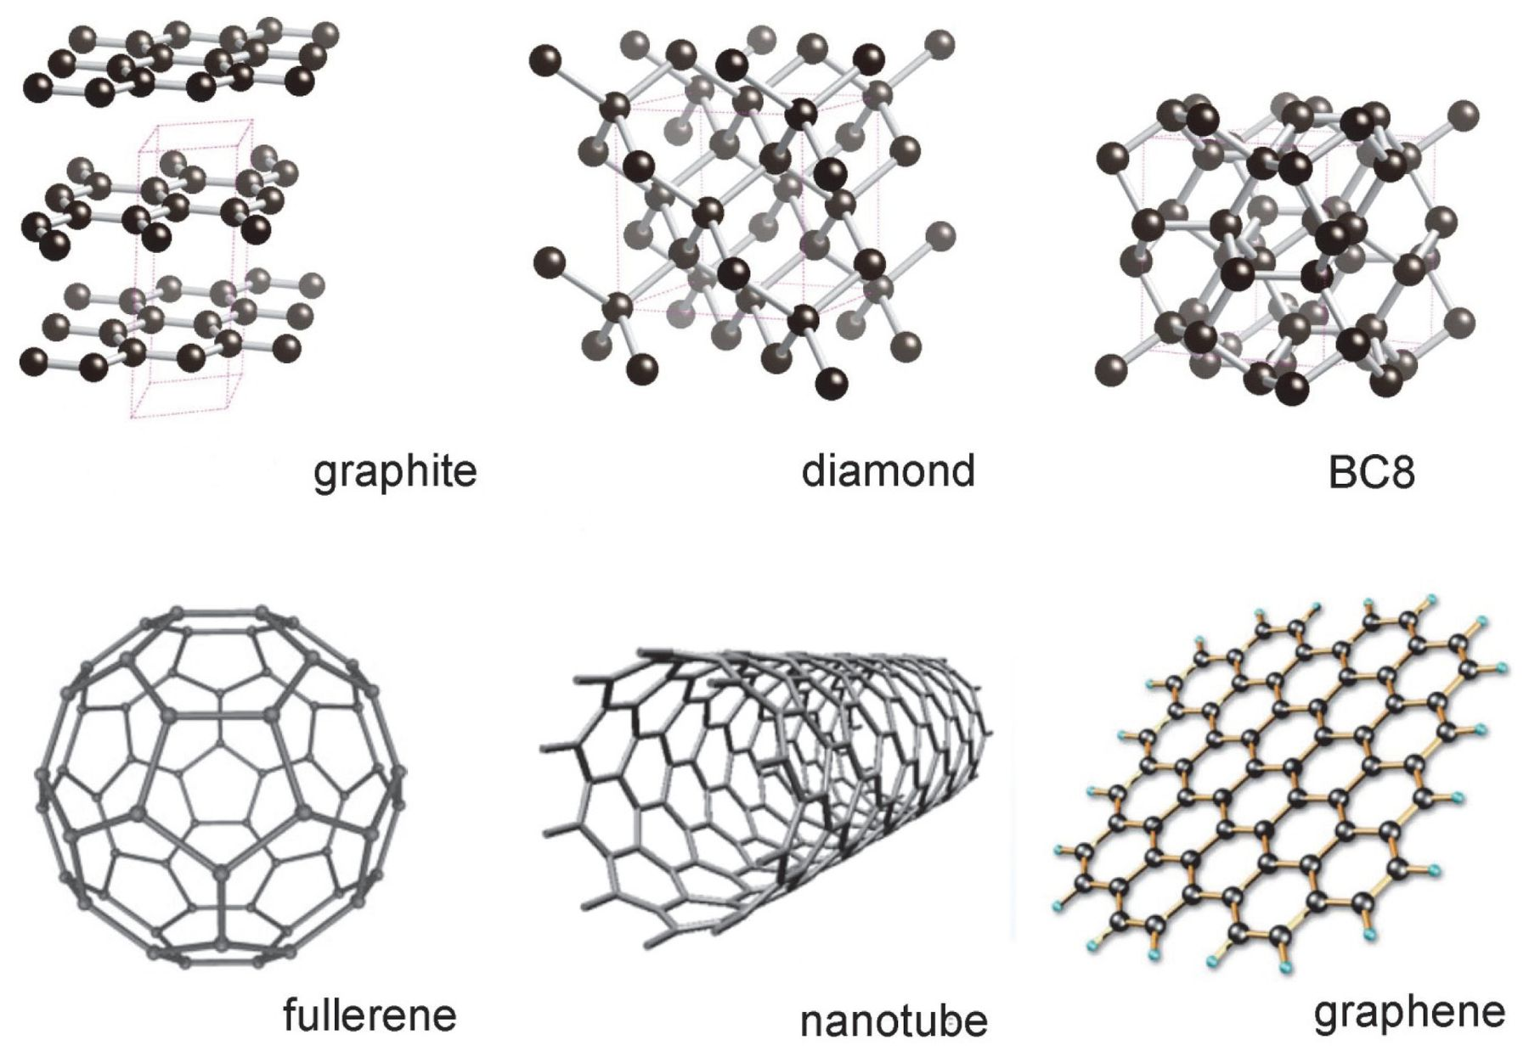
Carbon allotropes
Allotropy is the property of some chemical elements to exist in several different geometries (known as allotropes) in the same physical phase

Slide 3
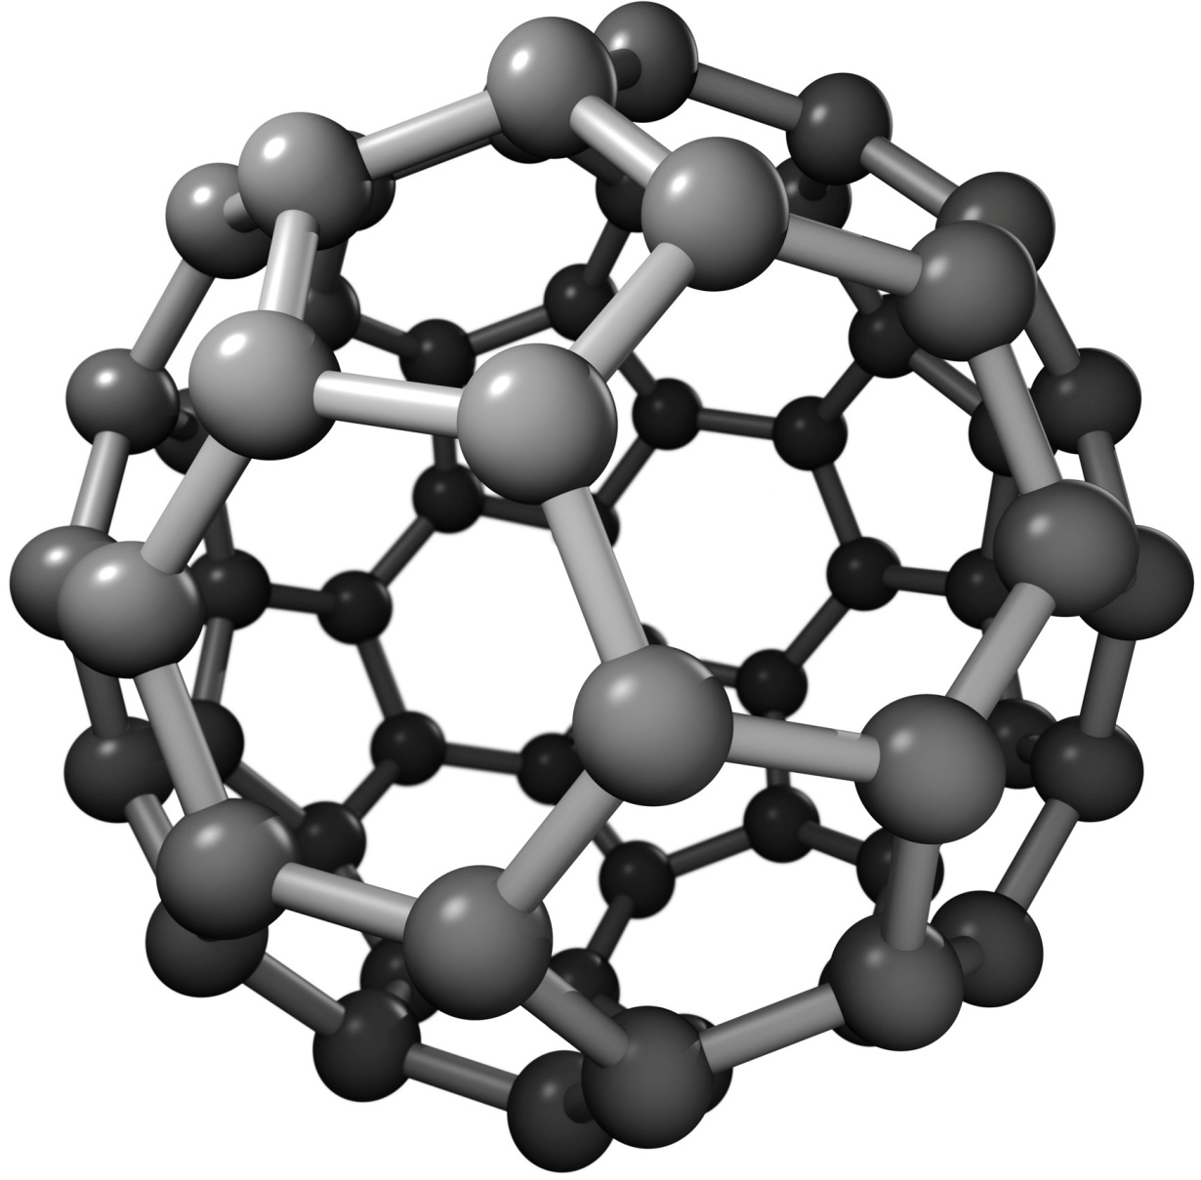
The Buckyball
The Buckminsterfullerene (named after inventor Richard Buckminster Fuller) was one of the first nanoparticles to be discovered (1985)
Number of atoms: 20 to over 100; the most common type (C60) contains 60 carbon atoms
Modifying a buckyball by adding or replacing an atom in order to change the properties of the buckyball is called functionalization

Slide 4
Uses
Armor. Hard as diamonds, buckyballs are potentially useful within armor
Medicine. Functionalized buckyballs can be made soluble by body cells, and hence find the following medical applications:
  As antioxidants, because of their ability to absorb electrons in free radicals
  In targeted drug delivery. The buckyball encases a minute dose of a particular drug. By controlling the functionalization of the buckyball the drug is absorbed only by the necessary cells
Fiber optics. Because of their perfect spherical shape, buckyballs are able to transmit light

Slide 5
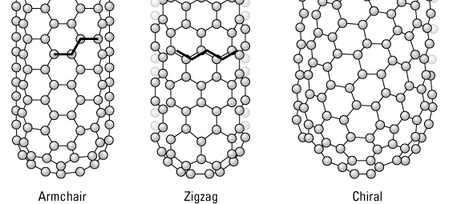
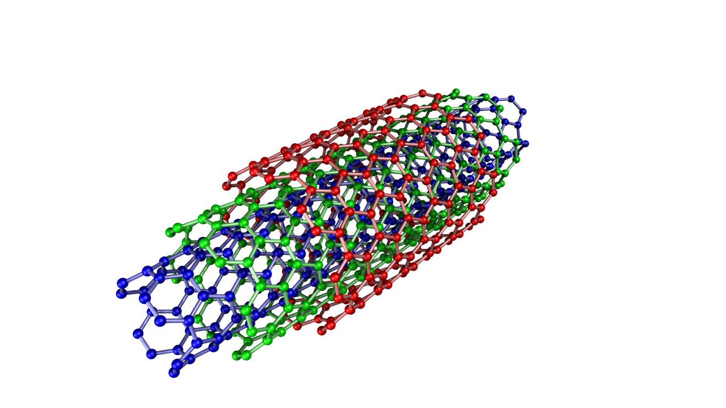
The Nanotube
Diameter < 1nm
A few nano- up to a millimeter in length
Symmetry: armchair, zig-zag, chiral
Single/multiple wall CNTs
Compared to steel:
  100 × more difficult to tear apart
  5 × as elastic
  a quarter density
High thermal conductivity
Metallic/semi-conductive contingent on symmetry

Slide 6
Uses
Medicine: functionalization, as well as their natural fluorescence, enable the use of CNTs as chemical sensors; they have also been shown to fuse well with bone, which could be used to diminish the implant rejection rate
Conductive plastics: CNTs are the best known conductive fillers because of their high aspect ratio
Energy storage: good battery electrodes due to high surface area (~1000 m²/g), good electrical conductivity, and linear geometry; the high surface area and thermal conductivity also make them useful as electrode catalysts in fuel cells
Molecular electronics: their geometry, electrical conductivity, and the ability to be precisely derived, make CNTs invaluable connectors between switches at the nanoscale; their properties as semiconductors also make them usable as switches themselves

Slide 7
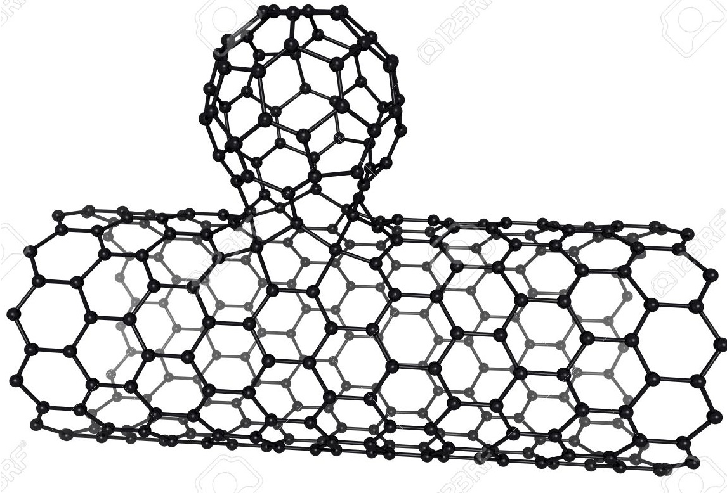
The Nanobud
A nanotube with a fullerene ball attached to it
As chemically reactive as the fullerenes, as electrically conductive as the nanotubes
The fullerene buds serve as additional anchors, modifying the mechanical properties of the whole structure
Efficient field emitters, with the emission threshold 0.65 V/µm (a third of that of the nanotubes)
Highly scalable production processes, therefore applications of industrial importance

Slide 8
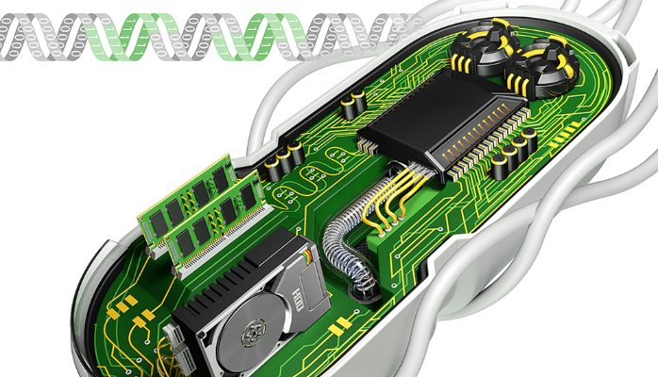
Synthetic biology
A set of technologies to construct living organisms with desired phenotypes

Slide 9
Systems biology studies complex biological systems as integrated wholes
Synthetic biology studies how to build such systems for engineering applications
Living systems provide a rich medium for controlling and processing
  Information
  Materials
  Energy
Bacteria are the simplest known natural objects capable of replicating

Slide 10
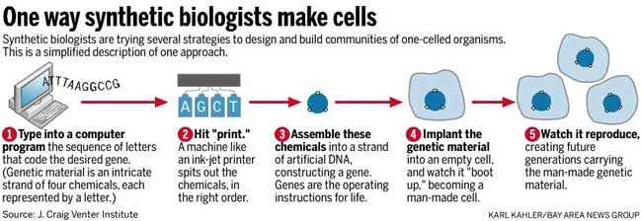
Enabling technologies:
Standardization of DNA parts (BioBrick plasmids)
DNA synthesis
DNA sequencing
Modular protein assembly

Slide 11
Uses
Materials. DNA synthesis and DNA sequencing have enabled the construction of microorganisms with specially engineered metabolic cycles. This is used in a variety of production processes: BioIsoprene, BioAcrylic, “Green Chemicals”
Vaccines. Bio Technologies provide tools to formulate vaccines via molecular engineering and DNA sequencing
Fuel. Sugars from non-food biomass can be used to manufacture biofuels and renewable chemicals that are currently produced from expensive and price-volatile petroleum feedstocks
Waste disposal. Bioplastics made from fermented sugars can be biodegraded by microbes already existing in soil and water environments

Slide 12


Slide 13
The internetworking of physical devices to allow collection and exchange of information
An instance of the more general class of cyber-physical systems:
  Smart grids
  Smart homes
  Smart cities
  Intelligent transportation
Made by equipping all physical objects with identifying devices
By 2020 there expected to be 20 billion connected devices
The Internet of Things will therefore depend on the adoption of IPv6 to accommodate for the large address space

Slide 14
Enabling technologies
Some of the top 10 IoT-enabling technologies Gartner (IT research and advisory firm) identifies as most in-demand in 2017--2018:
IoT security: IoT devices are open to both information and physical attacks, and many of them lack the processors and OS to afford sophisticated security approaches
IoT analytics: IoT business models require new algorithms, data structures, machine learning approaches to profit from the data that will become available
IoT device management: as the devices comprising the IoT will find themselves in a variety of contexts, locations, physical states, the challenge is to develop data structures capable of learning and adapting to circumstances

Slide 15
IoT processors: processor architecture defines the device capabilities, such as security, firmware updatability, ability to support device management agents, etc.
IoT OS: traditional OS consume too much power, need fast processors, lack guaranteed real-time response, require too much memory. A range of specialized IoT OS has been developing
Event stream processing: distributed stream computing platforms (DSCPs) have emerged to address the need to analyze the extremely high data rates generated by some IoT applications (telecom, telemetry) on-line
IoT standards: IoT devices need to interoperate, and IoT business models rely on sharing data between multiple devices and organizations

Slide 16
Uses
The employment of the IoT leads to the following benefits:
In manufacturing:
  Connected factory: reduce downtime, increase productivity, maintain industry compliance
  Connected machines: optimize processes, improve overall equipment effectiveness, secure operations
  Connected supply chain: drive faster decision-making, reduce risk, improve supply chain visibility
In the energy field, smart grids enable pervasive monitoring and control of energy distribution networks to enhance energy delivery and reduce carbon emission
In transportation:
  on-line traffic analysis improves logistics (smart infrastructure, smarter personal choices)
  on-board wi-fi, real-time video, smart ticketing, centralized operations enhance mass transit and passenger experience

Slide 17

Neural interfaces

Slide 18
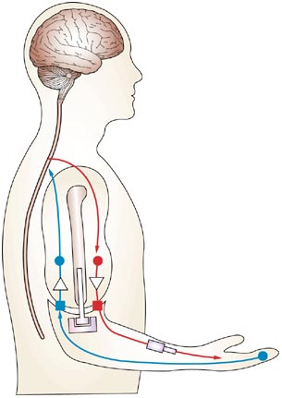
A brain-computer interface (BCI) is a direct communication pathway between a wired brain and an external device
Research and development are focused primarily on neuroprosthetics applications
Was made possible by the development of electroencephalography (EEG)

Slide 19
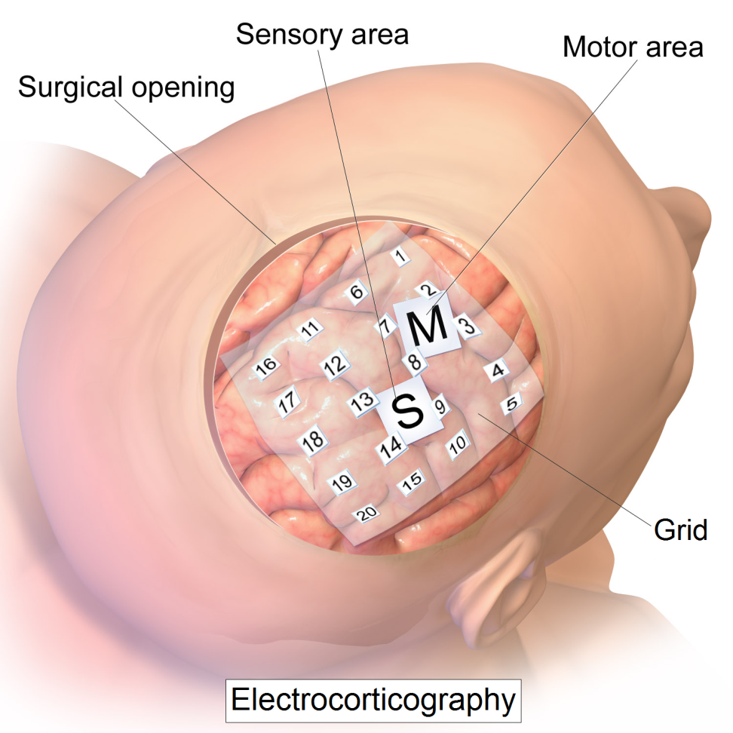
Types of interfaces
EEG-based:
  Electrocorticography: electrodes embedded in a plastic pad are placed above the cortex, beneath the cranium
Non-EEG-based:
  Pupil-size oscillation: an eye's pupil contracts according to the brightness of the looked at object

Slide 20
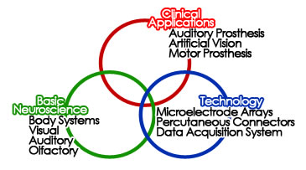
BCI applications

Slide 21

Educational technology
Learning theory
  Behaviorism
  Cognitivism
  Constructivism
Computer-based training
Online learning (Coursera, etc.)
Mobile learning

Slide 22
Top technologies: AI, VR, VW
AI. Customized learning-experience is already a reality. An intelligent tutoring system consists of:
  learner model to assess how the student is doing
  tutoring model to determine what material to present next
  domain model to represent it appropriately
VR. Learn by doing. One can now explore and interact with molecules and galaxies, thanks to virtual reality
VW. Socialization is a vital part in a person's development, and as it turns out, introverted kids don't feel anxious interacting online

Slide 23
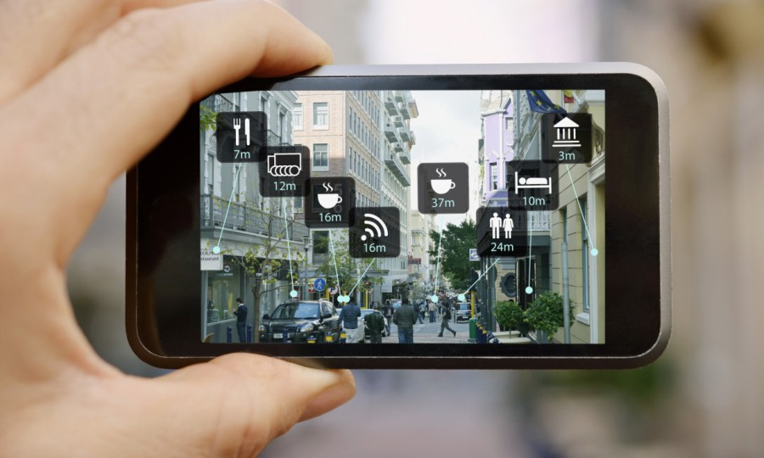
Top technologies: AR
Use the user’s context to specify information

Slide 24
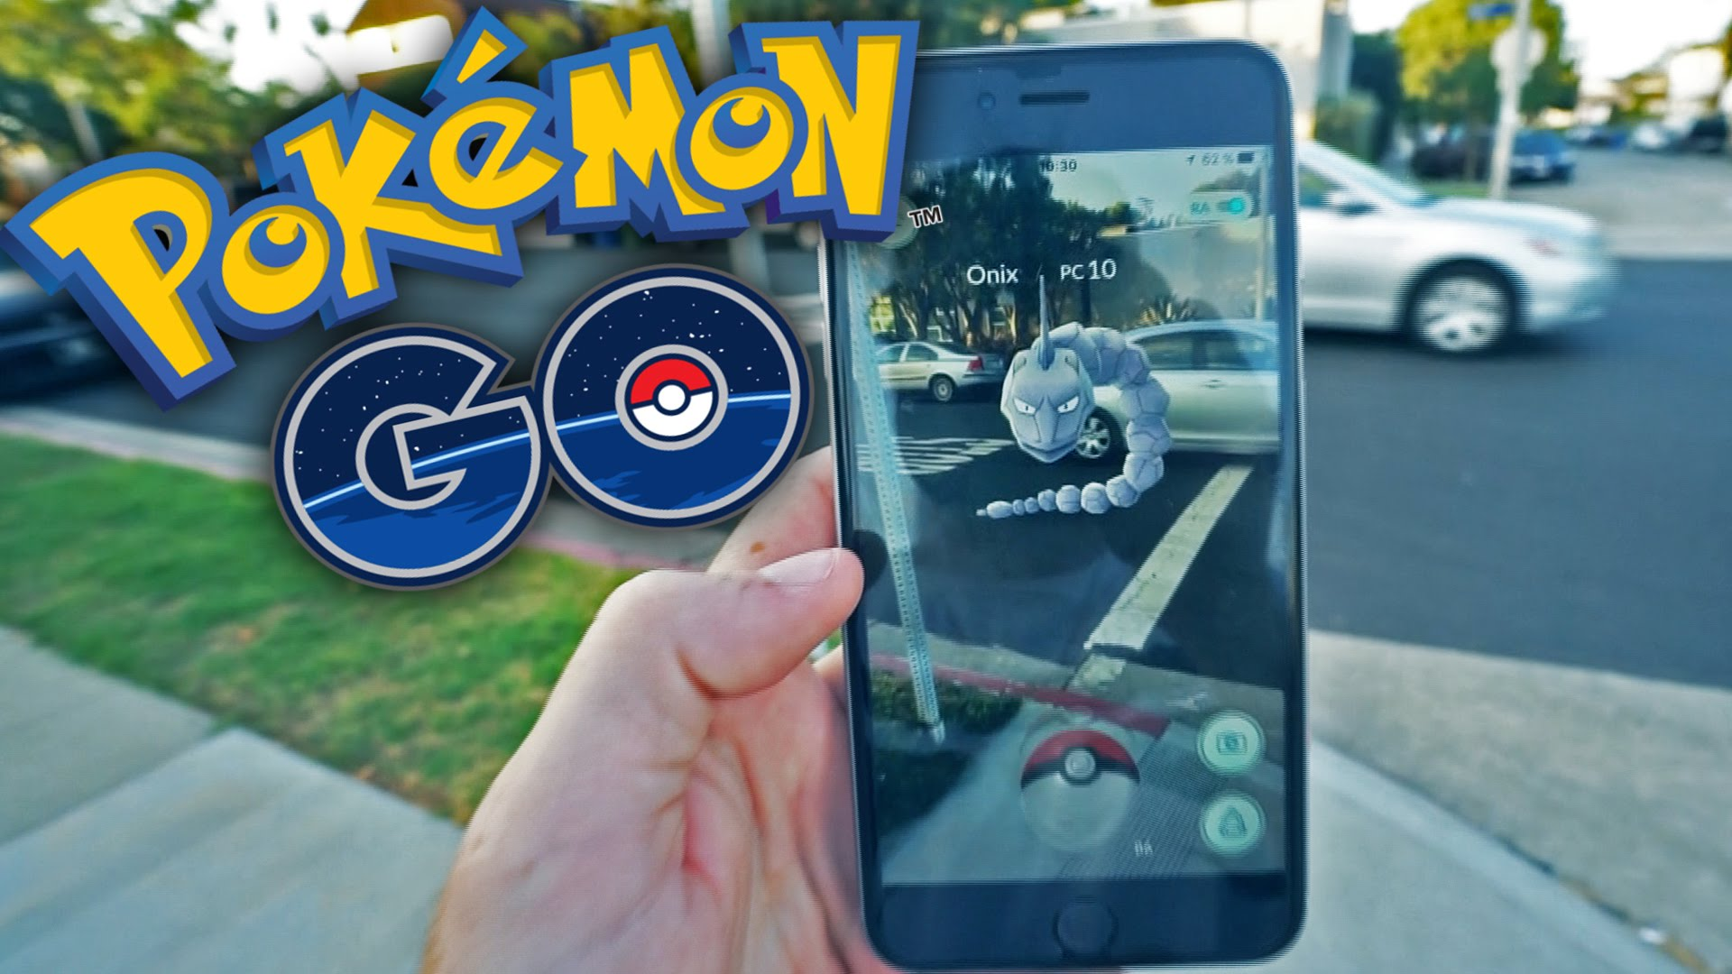
Top technologies: ARG
Enabling the use of communication tools typically used in the workspace, provides learning opportunities by situating important decisions in a thematic story

Slide 25
References
Understanding Nano.
Cheap tubes.
Biology Innovation Organization.
Synthetic biology.
CISCO.
Gartner.
Crel.
Nicolas-Alonso.
Sebastiaan Mathot.
Clark Quinn.

